Slide 1
Event Driven Architecture
Vaccine Transportation Use Case
Jerome Boyer
DE – Event Driven Solution CTO
Cloud Garage Solution Engineering

Slide 2
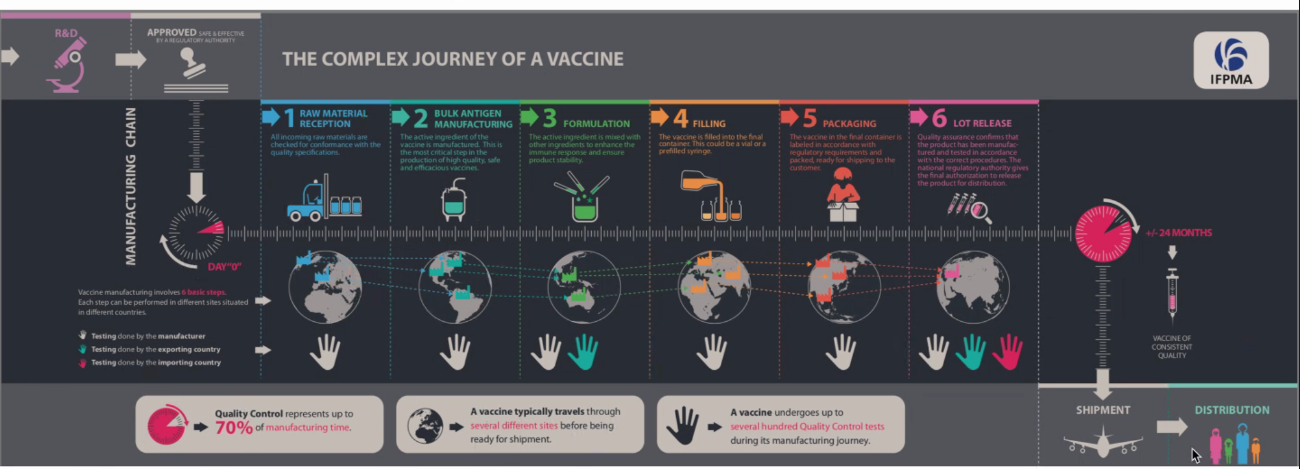
A modern way to manage the vaccine shipment process

Slide 3




Delivering Vaccines at Scale Solution
LifeScience
Vaccine Partner
Government
Provider
Vaccine Distributor
Shipment Container
Omni Channel
Ecosystem & Partners
Hotspot
Detection
Faulty Container
Monitoring
Vaccine
Distribution Optimization
Vaccine
Program Success
Order Management
Crime
Prevention
Intelligent
Workflows
Cognitive Solutions
with trust
Blockchain
API l Business Microservices l Open Ecosystem | Events Processing |
Security and Compliance Framework
IBM Cloud Paks
Application l Integration l Automation l Security l Data l MCM
Operating environment
Open Hybrid Multicloud
Edge
Private Cloud
Core Systems
Z Power

Slide 4
Business Requirements
Time to market:
Speed to innovate and shorten time to deploy to production
design thinking, even storming, microservices, small team, devops, ML ops...
Complex end to end solution
business partners involvement, trust in data, single source of truth:
blockchain
IT, Data, AI: hot spot, vaccine lot shipment plan optimization
Business partner data sharing:
Event driven, asynchronous, IoT telemetries, cold chain monitoring
Scale solution worldwide
multi-cloud deployment

Slide 5
High Level Architecture
Freezer IoT
Freezer IoT
Decentralize Identity
Order Mgr
API
Shipment Plan Optimizer
Security
Refrigerator Container Mgr
Cold Chain Monitoring
Blockchain Ledger
Multi-cloud management
Event Backbone
AI Anomaly Detection
Event Injection Layer
Itinerary Mgr
Transportation Tracking
ERP
Legacy Order Mgr

Slide 6
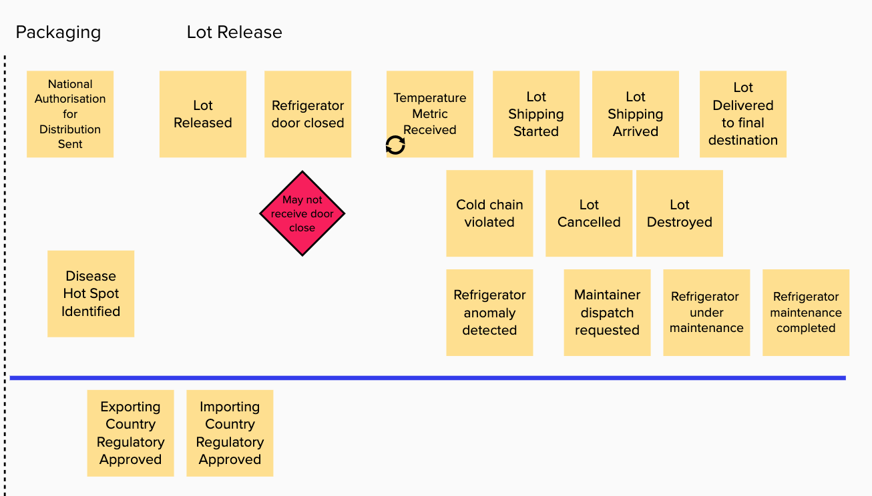
Understanding the process
Event Storming Goals
Understand the end to end business process from an event point of view
Cloud Native app
Domain Driven Design

Slide 7
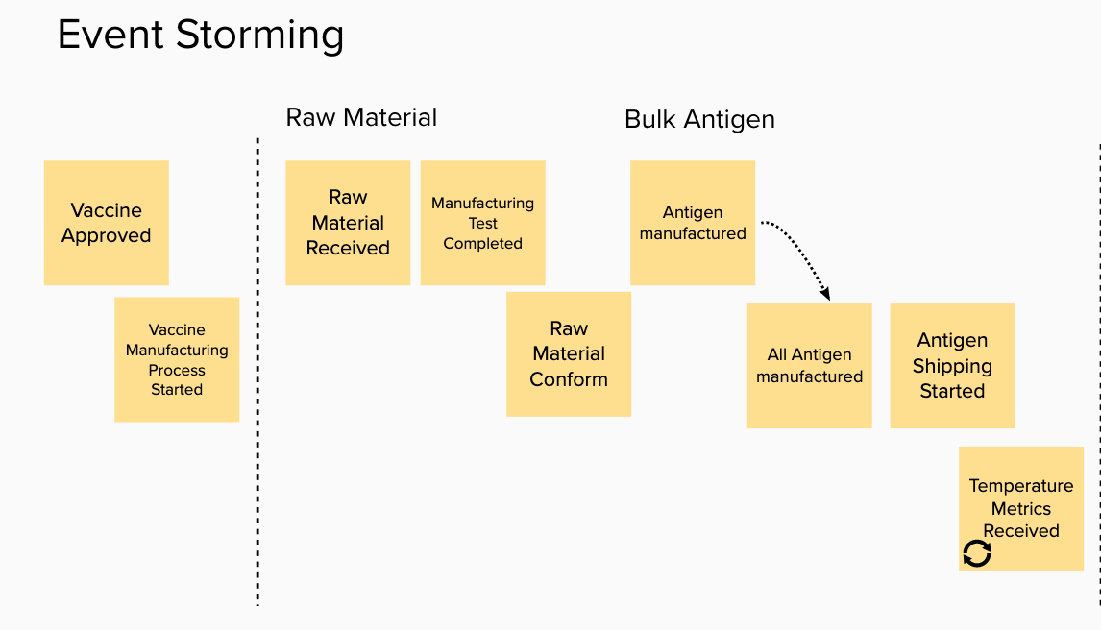
Vaccine Process – Event Storming

Slide 8
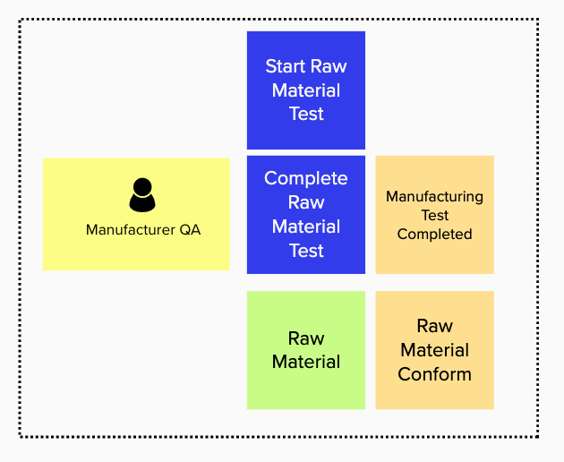
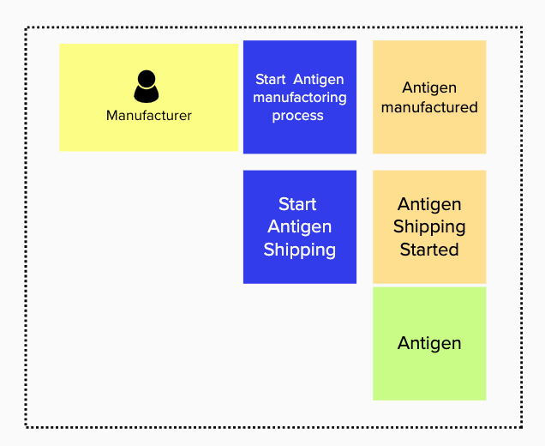
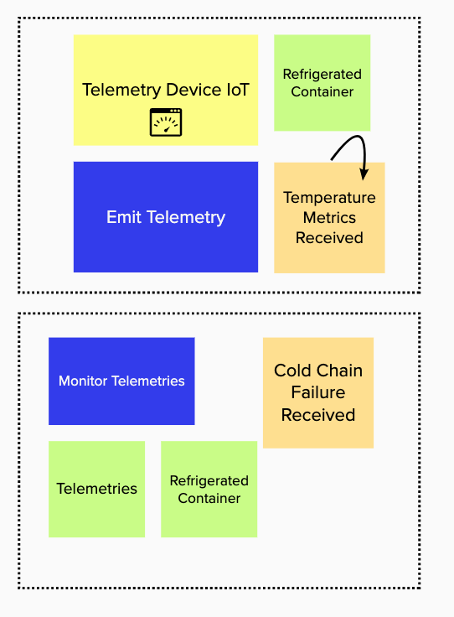
Bounded Contexts : Applying DDD
Entities, Commands, Actors -> Bounded contexts

Slide 9
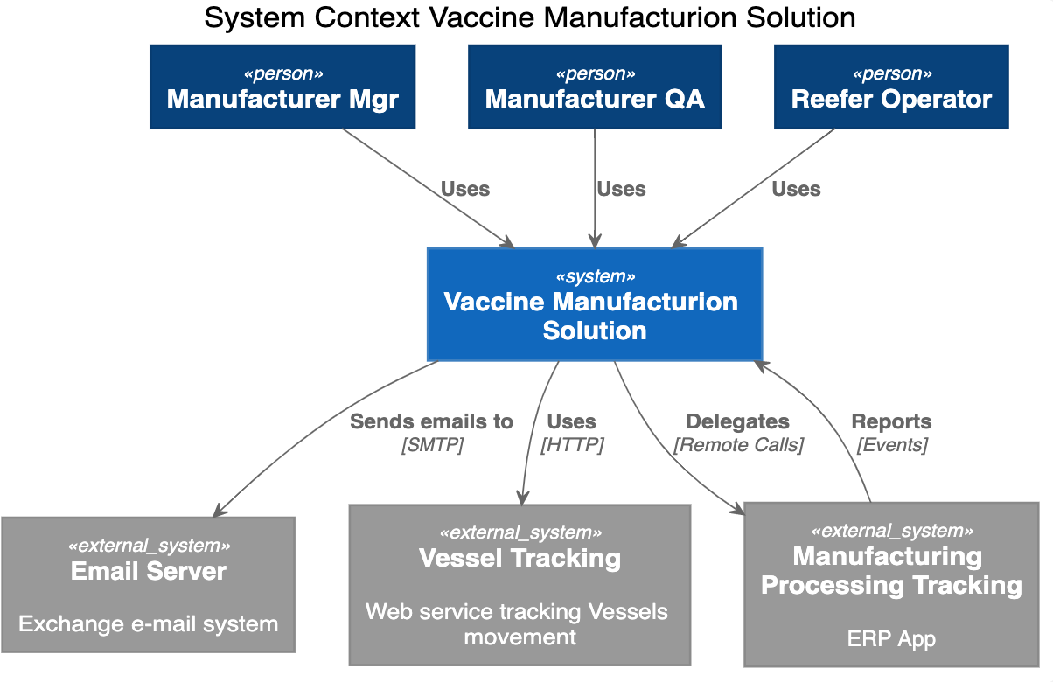
System Context

Slide 10
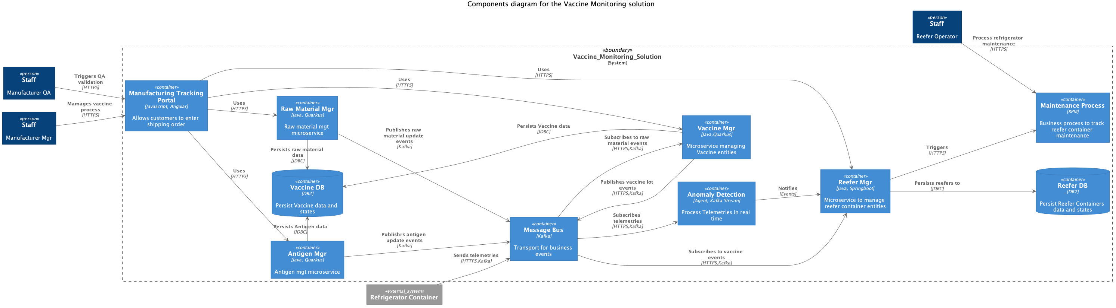
Container View

Slide 11
Deployment View

Slide 12
Cloud Paks – Pre-integrated for cloud use cases
Today, IBM offers clients the first five Cloud Paks…
IBM Cloud Pak for Applications
Build, extend deploy, and run applications
IBM Cloud Pak for
Data
Collect, organize, and analyze data
IBM Cloud Pak for Integration
Integrate applications, data, cloud services,
and APIs
IBM Cloud Pak for
Automation
Transform business processes, decisions, and content
IBM Cloud Pak for
Multicloud Management
Multicloud visibility, governance, and automation
IBM containerized software
IBM containerized software
IBM containerized software
IBM containerized software
IBM containerized software
Operational services
Operational services
Operational services
Operational services
Operational services
Container platform
Container platform
Container platform
Container platform
Container platform
Pre-integrated Systems
IBM Confidential
IBM Cloud / © 2019 IBM Corporation
12

Slide 13


Cloud Pak for Integration
A faster, more secure way to move your core business applications to any cloud through enterprise-ready containerized software solutions
IBM containerized software
Complete yet simple
IBM certified
Run anywhere
API Lifecycle
App & Data Integration
Enterprise Messaging
Events
High Speed Transfer
Integration Security
Container platform and operational services Logging, monitoring, security, identity access management
13

Slide 14
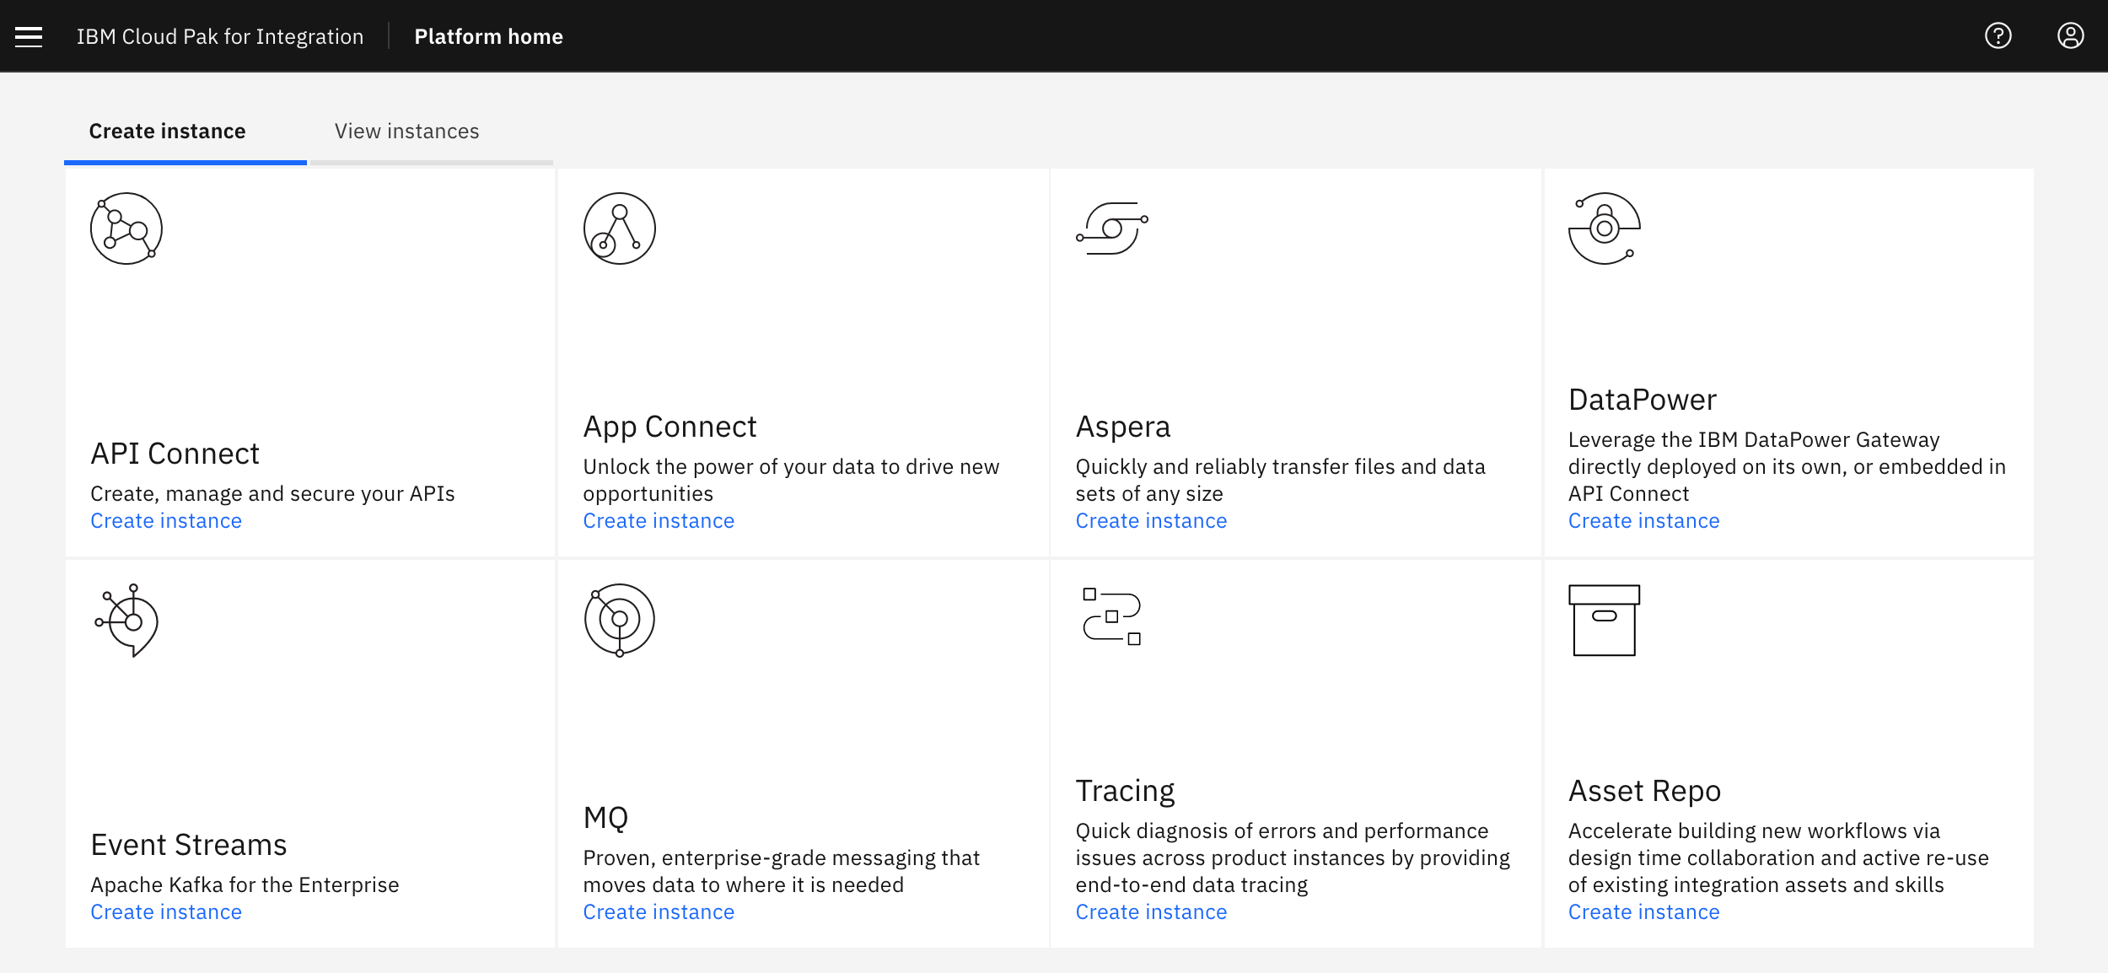
Apache Kafka Orchestrated with Kubernetes
Choose IBM Event Streams from the catalog to deploy a Kafka cluster with ease
It comes
Highly available
Secure
Ready for production

Slide 15


Integration
OpenShift
Vaccine At Scale Solution
Vaccine Order Mgr
Order Shipment Optimization
Reefer Mgr
Reefer Container
Simulator
Reefer Monitoring Agent
Kafka
0
1
2
3
0
1
2
3
0
1
2
3
0
1
2
3
0
1
2
3
orders
lot inventory
shipment plan
reefers
telemetries
Cloud Pak Integration
On-premise or Cloud Providers (IBM, AWS, GCP, Azure...)

Slide 16
Reefer IoT Simulator
Refrigerator Container
Simulator
telemetries
Event Streams
0
1
2
3
Cloud Pak Integration
OpenShift

Slide 17
Cold Chain Monitoring
Reefer Monitoring Agent
Anomaly Detection Scoring
Refrigerator Container
Simulator
Blockchain
telemetries
Event Streams
reefers
0
1
2
3
4
0
1
2
3
Reefer Manager
Cloud Pak Integration
OpenShift

Slide 18
vaccine-order-mgr
Vaccine Order Reefer Optimization
Vaccine Order Mgr
Blockchain
Order Entity
Order Events
Event Streams
0
1
2
3
4
0
1
2
3
CDC
orders
shipment plan
Cloud Pak Integration
OpenShift

Slide 19
vaccine-order-mgr
vaccine
Vaccine Order Mgr
Vaccine Order Optimizer
PV
Postgresql
Event Streams
Kafka Connect Cluster
Debezium Postgres Connector
Brokers
Zookeepers
Cloud Pak Integration
OpenShift

Slide 20

VORO components
OpenShift
vaccine-order-optimizer service
Vaccine Order Reefer Optimization
APP
Transportation Event Consumer
0
1
2
3
Order Resource
Refrigerator Event Consumer
0
1
2
3
Shipment Plan Optimizer
Lot Inventory Event Consumer
0
1
2
3
Data Repository
0
1
2
3
Shipment Plan Event Producer
Decision Optimization Service

Slide 21
Vaccine Order Refrigerator Optimizer
Vaccine Order Reefer Optimization
Manufacturer Simulator
Transportation Simulator
Refrigerator Manager
Vaccine Order Mgr
Event Streams
0
1
2
3
4
0
1
2
3
0
1
2
3
0
1
2
3
0
1
2
3
cdc
shipment plan
vaccine lots
transportation
reefers
orders
Cloud Pak Integration
OpenShift

Slide 22
Assess Business Entity Life Cycle life
Place Order
Order Settlement States
Order in transit States
Order Delivery and Complete
Modify Order
Voyages:
Full container
Ready
Created
(pending)
Full Container
Ready
Orders: Container delivered
Container delivered
Order: No
availability
Order: booked
Order: Container on ship
Orders: Completed
Order Booked waiting Reefer
Rejected
no Availability
Container
On Plane
Order completed
Order:
container
Allocated
Orders: Container off ship
Container
Allocated
Container
Off Plane
( Modifications
No longer accepted )
Order spoiled temp out of range
Containers: Temp OutofRange
Notes:
Focus on maturing the entity along its lifecycle
Identify role specific information required to mature the entity

Slide 23
Multi clouds deployment
Reefer
Simulator
Vaccine Order Mgr
Reefer Mgr
Maintenance Process
Reefer Planning Optimization
Anomaly Detection
Event
Streams
API Management
BAW
Watson ML
Cloud Pak For Integration
Cloud Pak for Automation
Cloud Pak For Data
MCM
OpenShift
OpenShift
OpenShift
On-premise or Cloud Providers (IBM, AWS, GCP, Azure...)

Slide 24
Cloud Pak for Application

Slide 25
Cloud Pak for Data

